Slide 1

Motilal Nehru National Institute of Technology, Allahabad Project on FRACTALS Course: MCA I Semester – Programming and Problem Solving
Submitted To: Prof. M.M. Gore Team Leader: Dibyendu Das (2025CA031)
Course: MCA 1st Semester
Subject: Programming and Problem Solving

Slide 2
Team Members:
Dibyendu Das (Leader)
Manish Kumar (Co-Leader)
Amit Singhad
Divyajeet
Jitendra Singh Parmar
Mohd Sufiyan
Piyush Gautam
Rajdeep Gupta
Rajeev Tirkey
Shri Krishan
Smruti Ranjan Behera
Sumit Raj Chaudhary

Slide 3

FRACTALS
Exploring the infinite complexity of the Mandelbrot, Julia, and Tricorn sets through escape-time algorithms

Slide 4

Fractals
Fractals are infinitely complex patterns that are self-similar across different scales. They are created by repeating a simple process over and over in an ongoing feedback loop.
Fractals are infinitely complex patterns that are self-similar across different scales. They are created by repeating a simple process over and over in an ongoing feedback loop.
Key Properties
• Self-similarity: Patterns repeat at every scale • Infinite detail: Zooming reveals endless complexity • Generated from simple equations • Appears throughout nature and mathematics

Slide 5
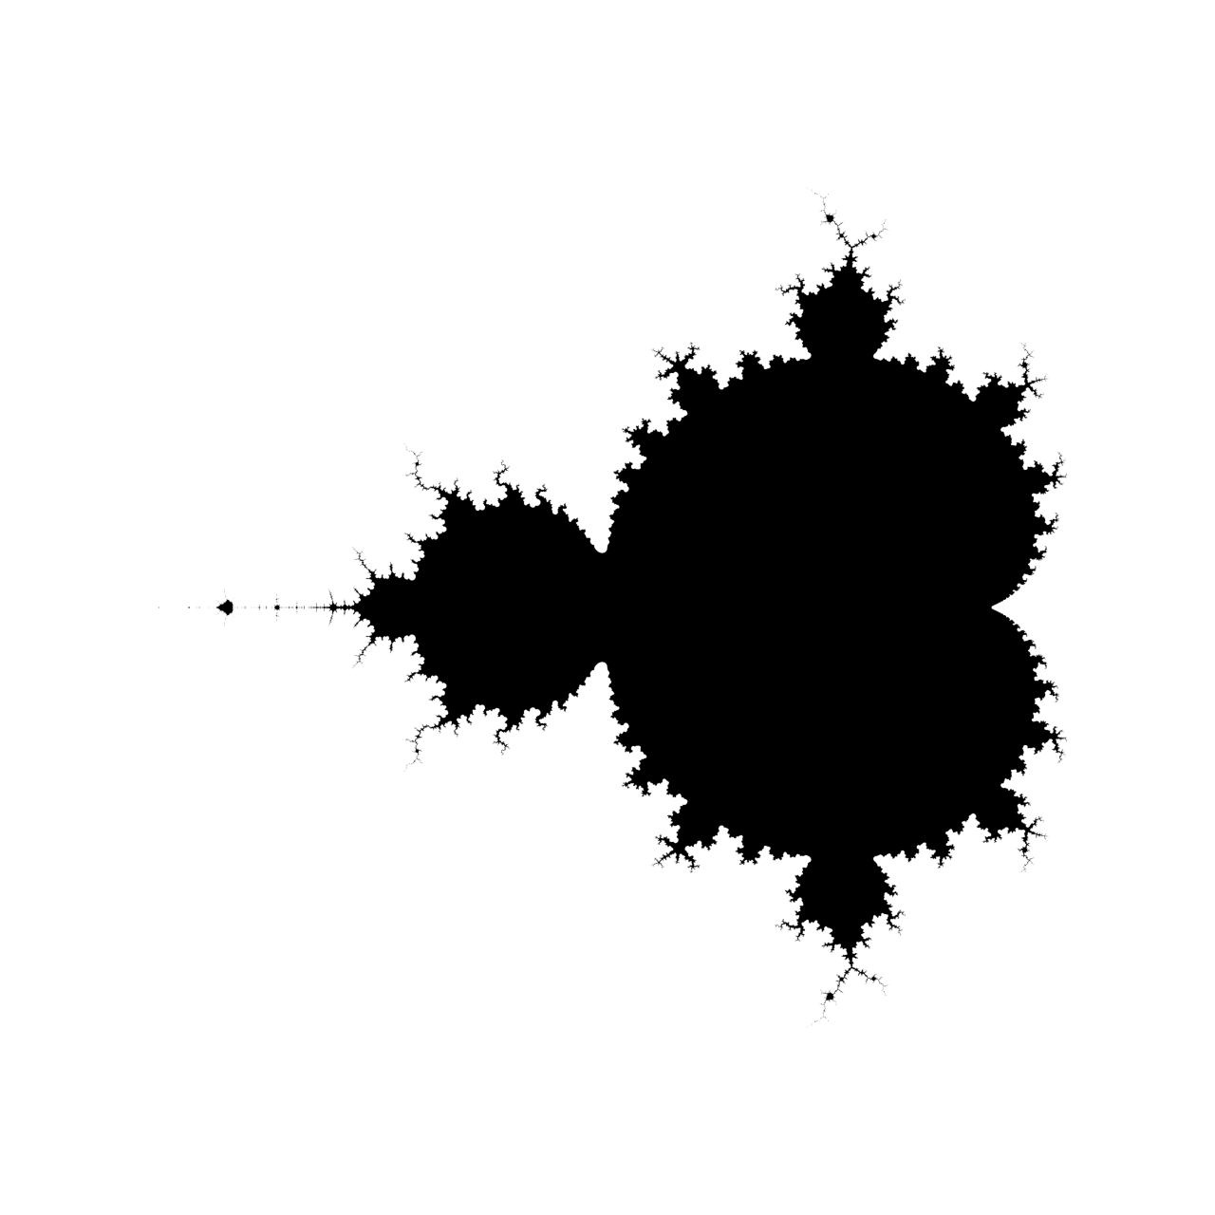
Mathematical Foundation: The Mandelbrot Set
The Iteration Rule
At each point c in the complex plane, we iterate:
Starting condition: z_0 = 0
The Escape Criterion
A point belongs to the Mandelbrot set if its orbit remains bounded—meaning |z_n| never exceeds 2, no matter how many iterations we perform.
Points that escape yield beautiful boundary patterns.

Slide 6
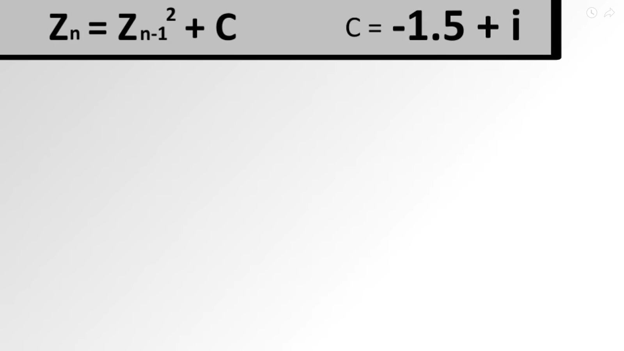
Math (Mandelbrot)

Slide 7
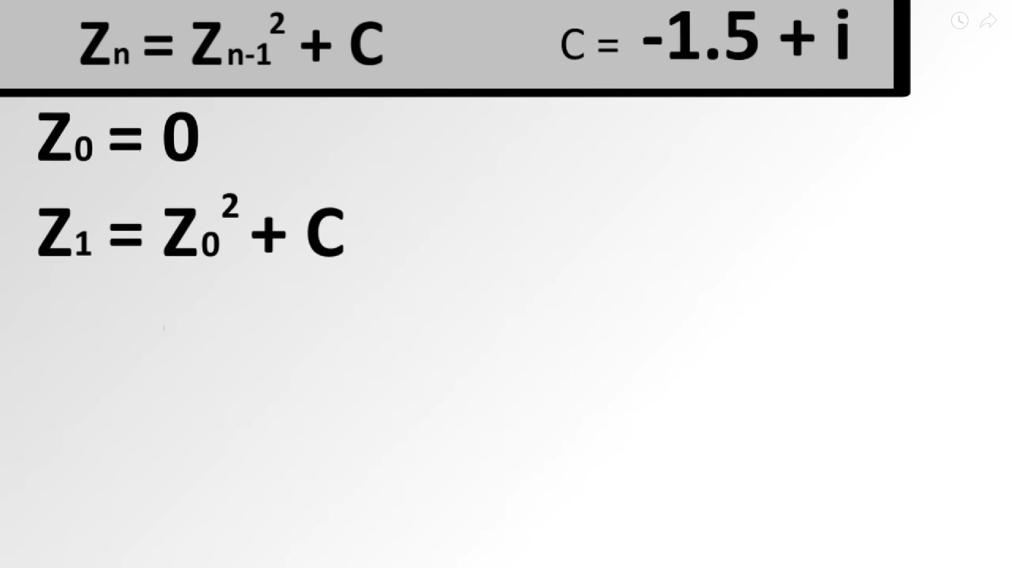

Slide 8


Slide 9
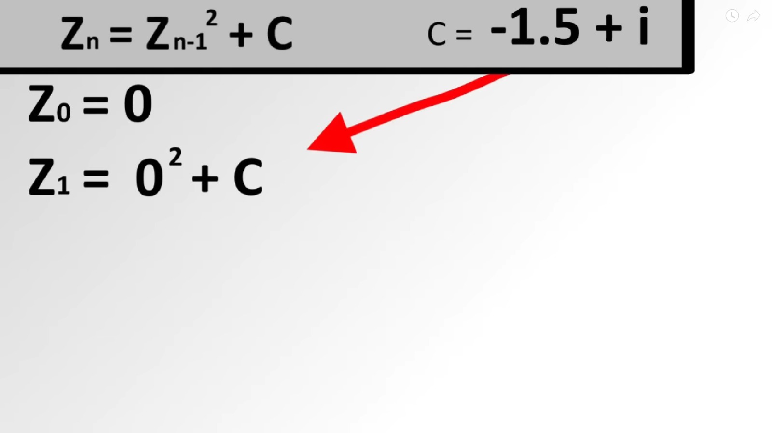

Slide 10
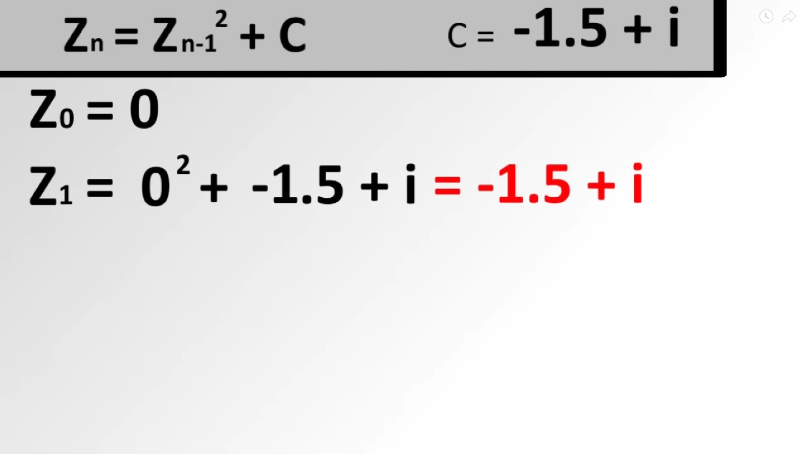

Slide 11
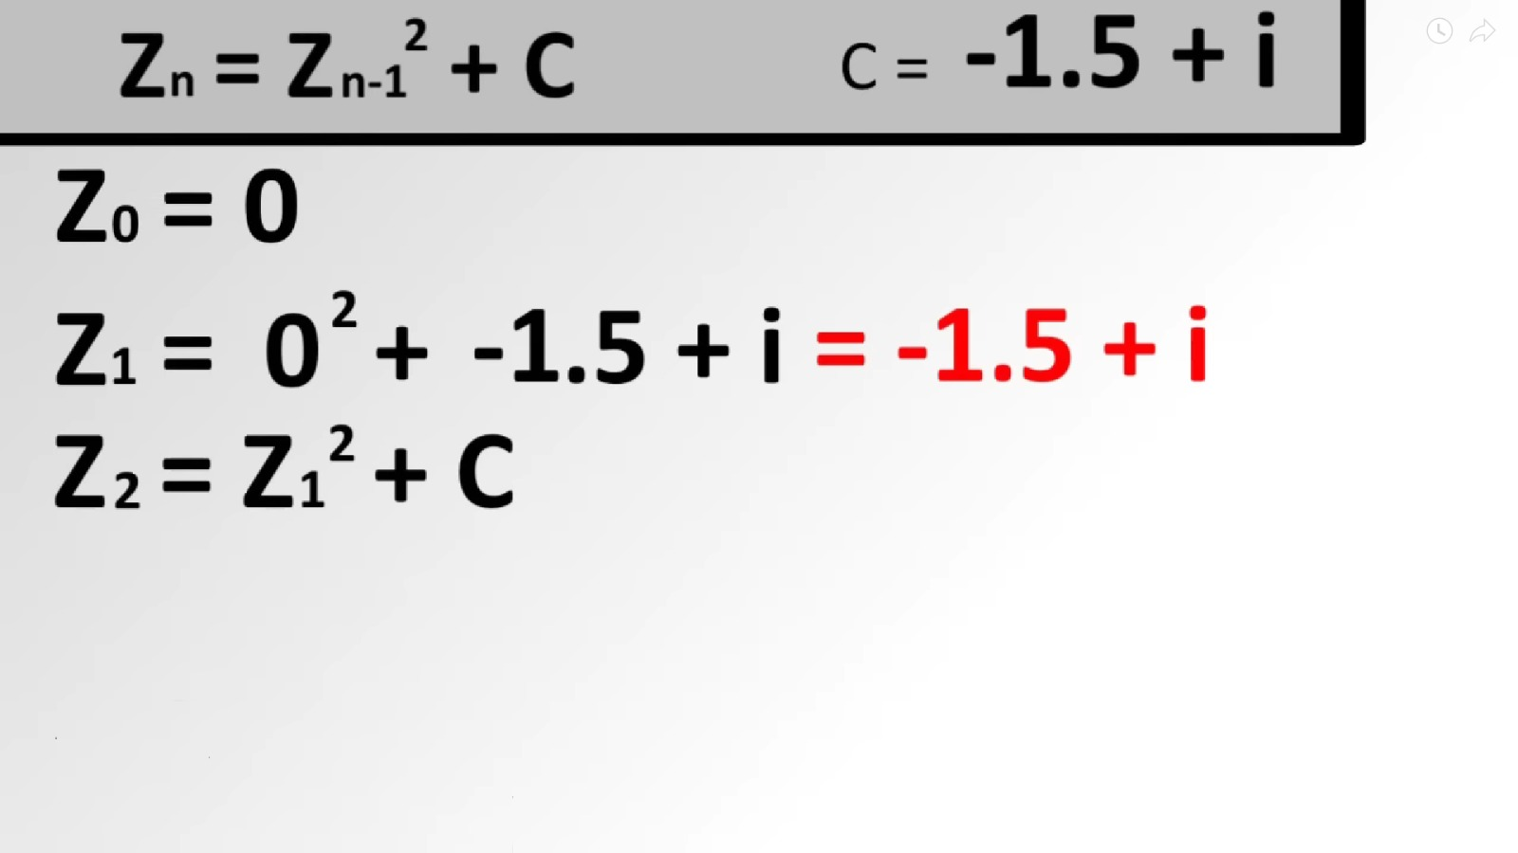

Slide 12
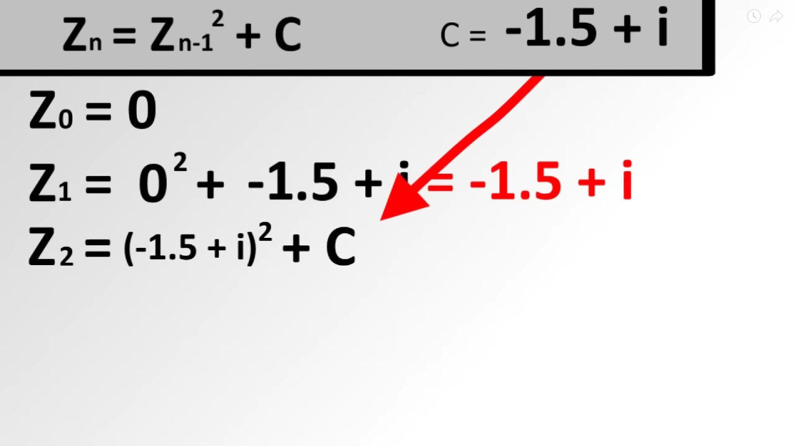

Slide 13
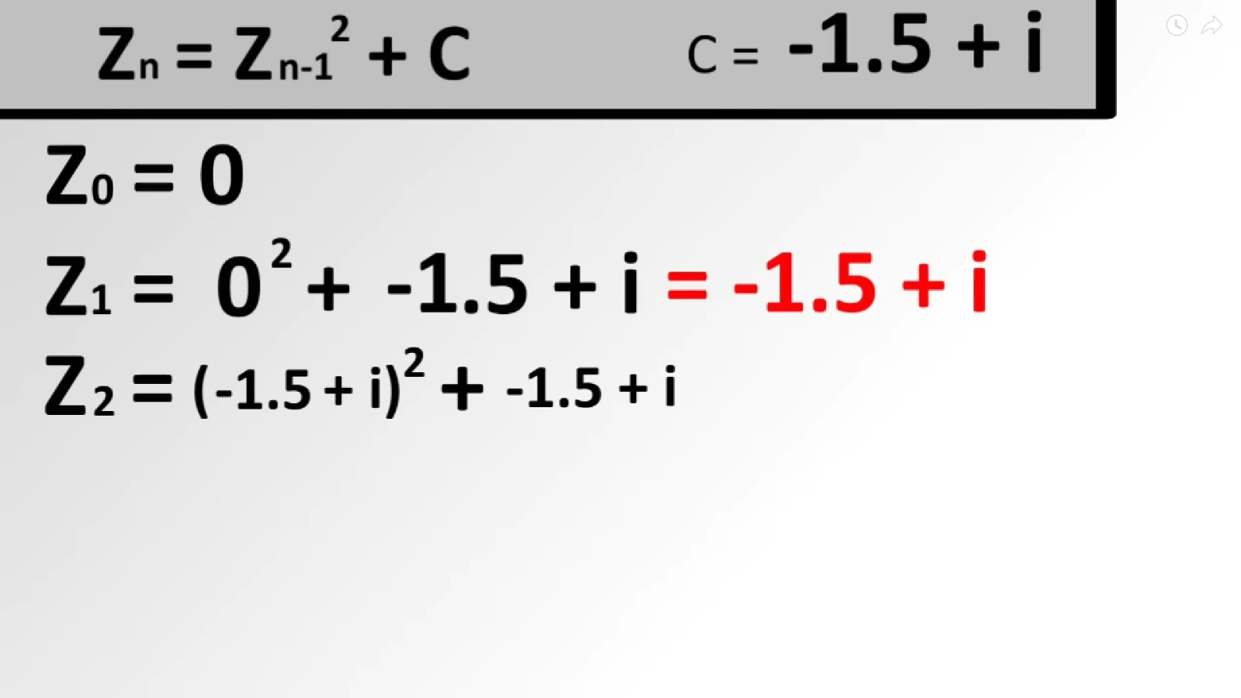

Slide 14
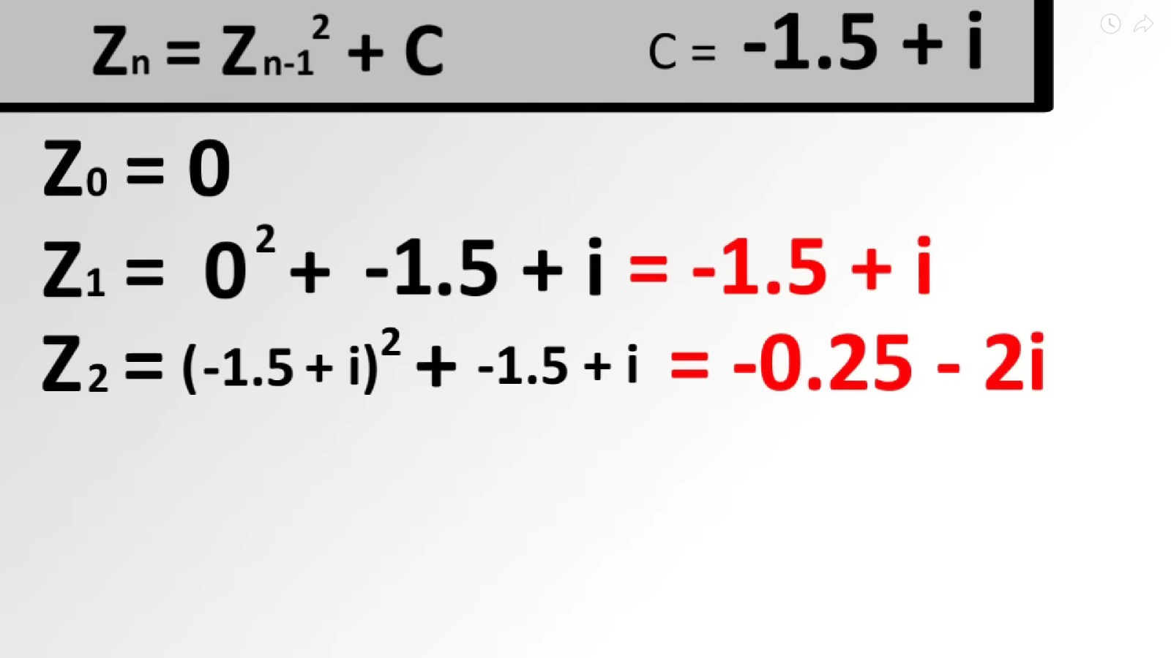

Slide 15
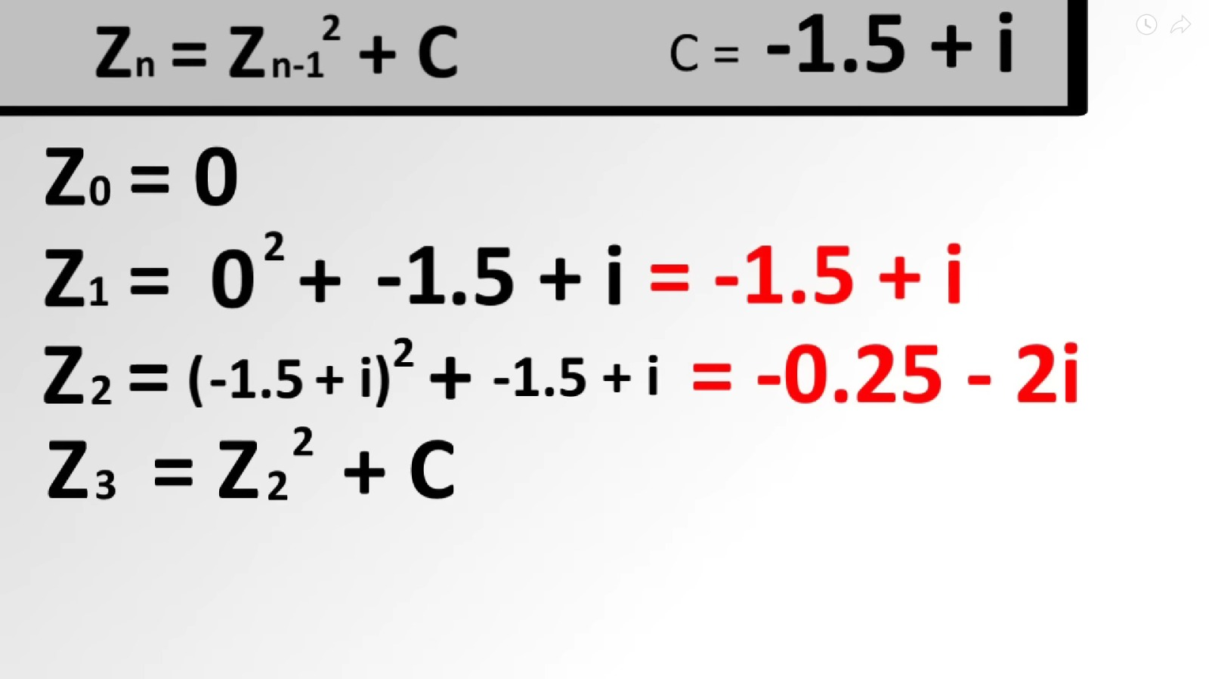

Slide 16
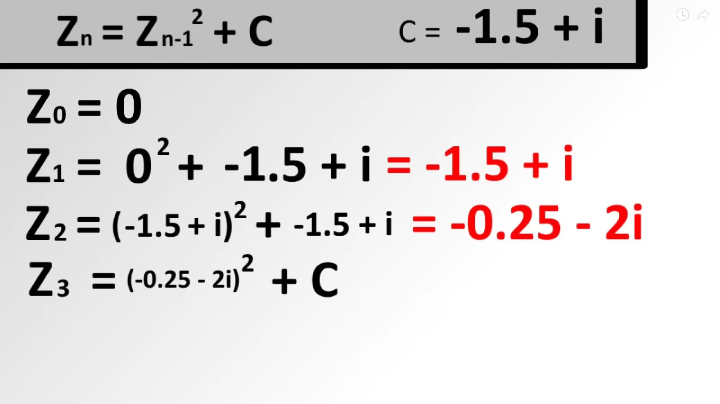

Slide 17
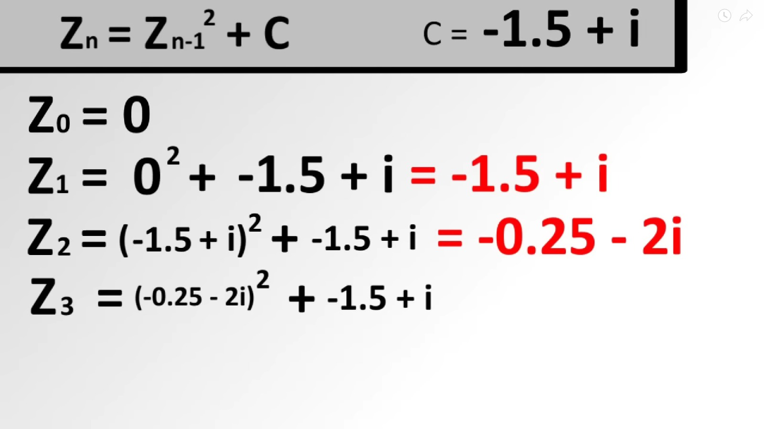

Slide 18
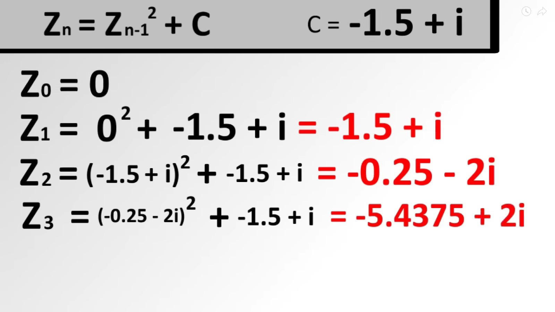

Slide 19
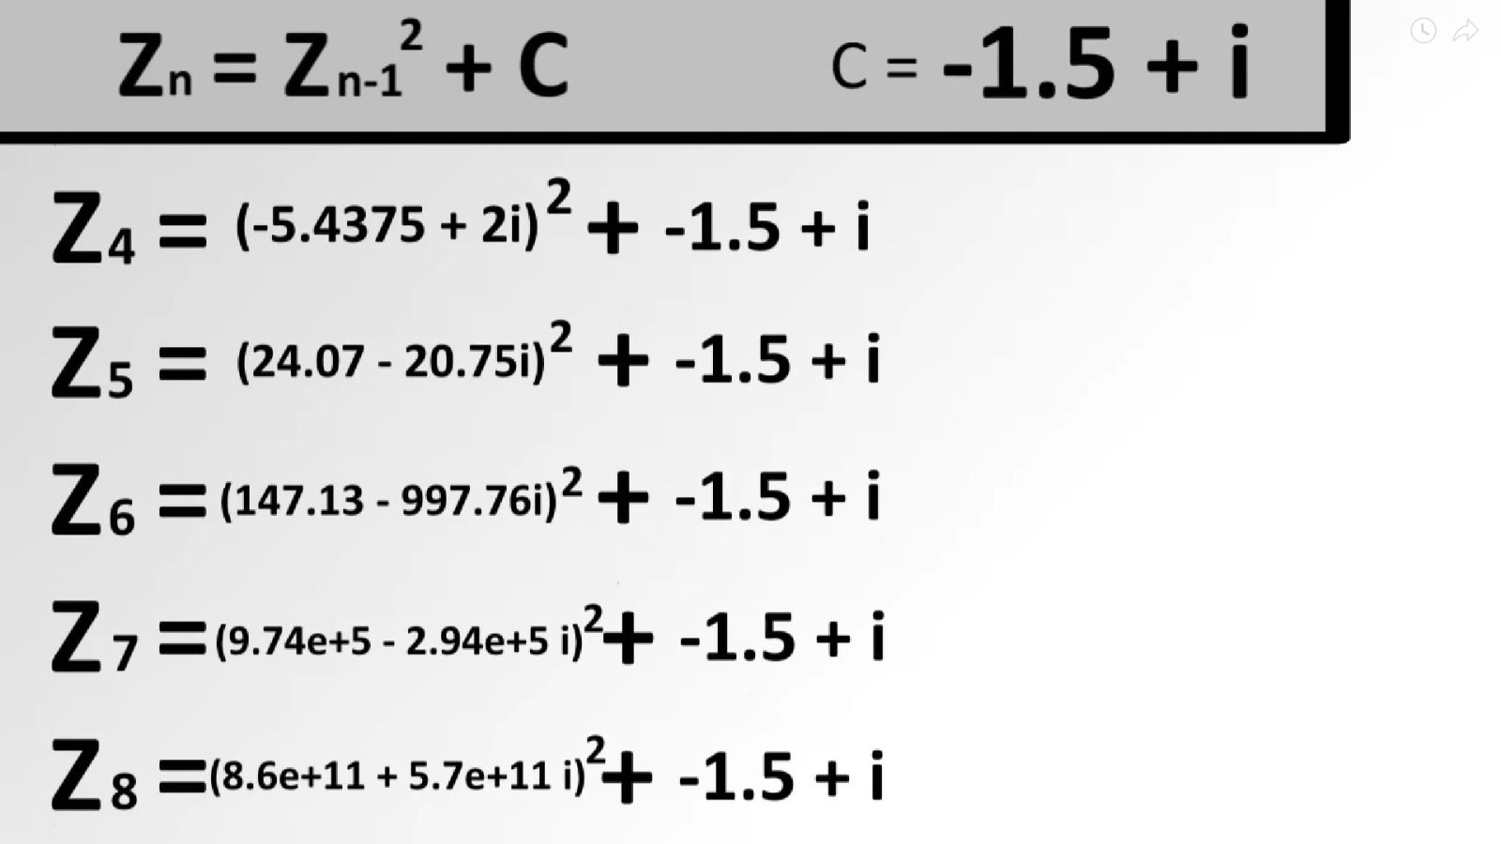

Slide 20
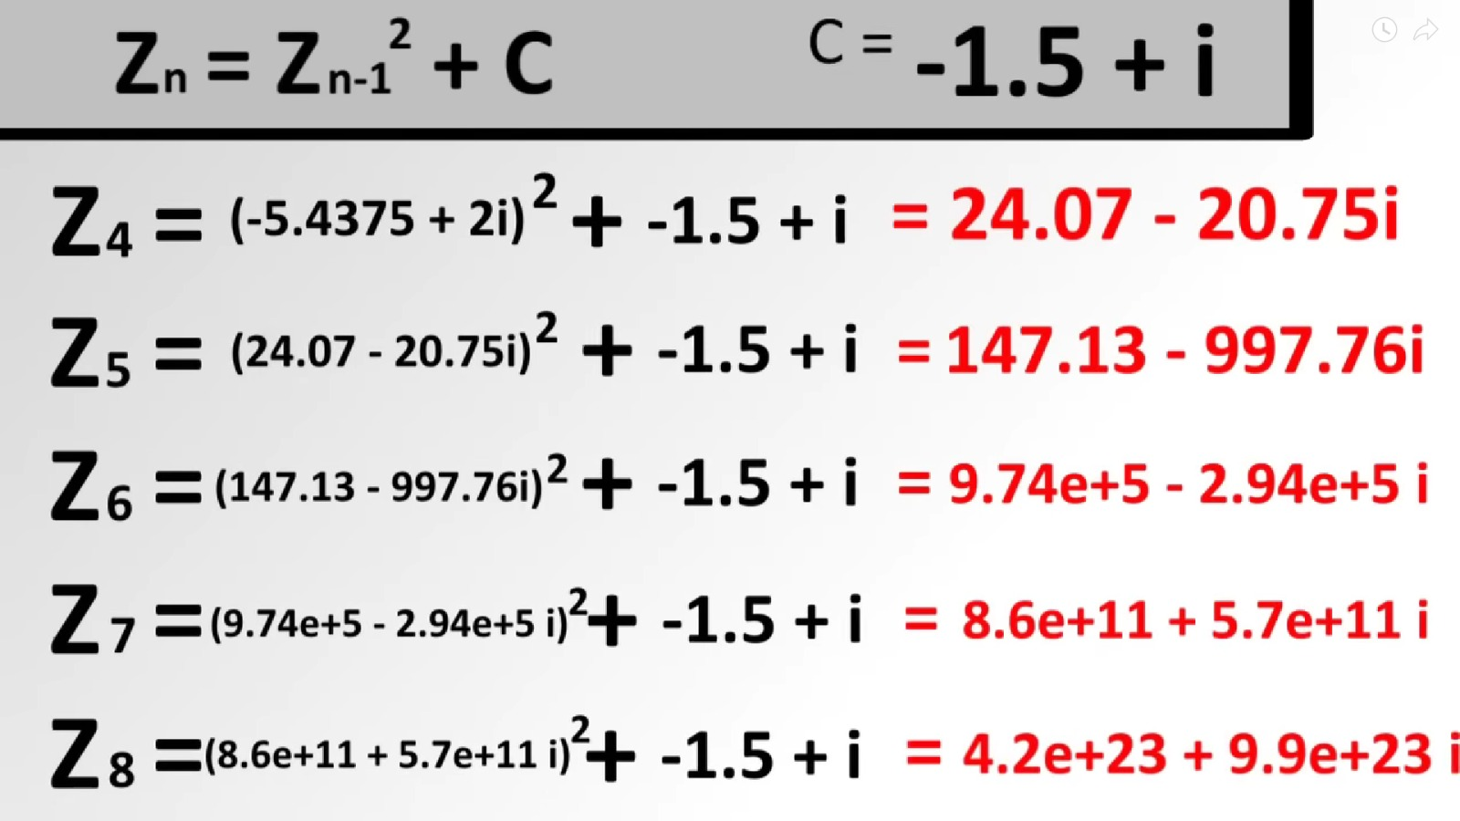

Slide 21


Slide 22
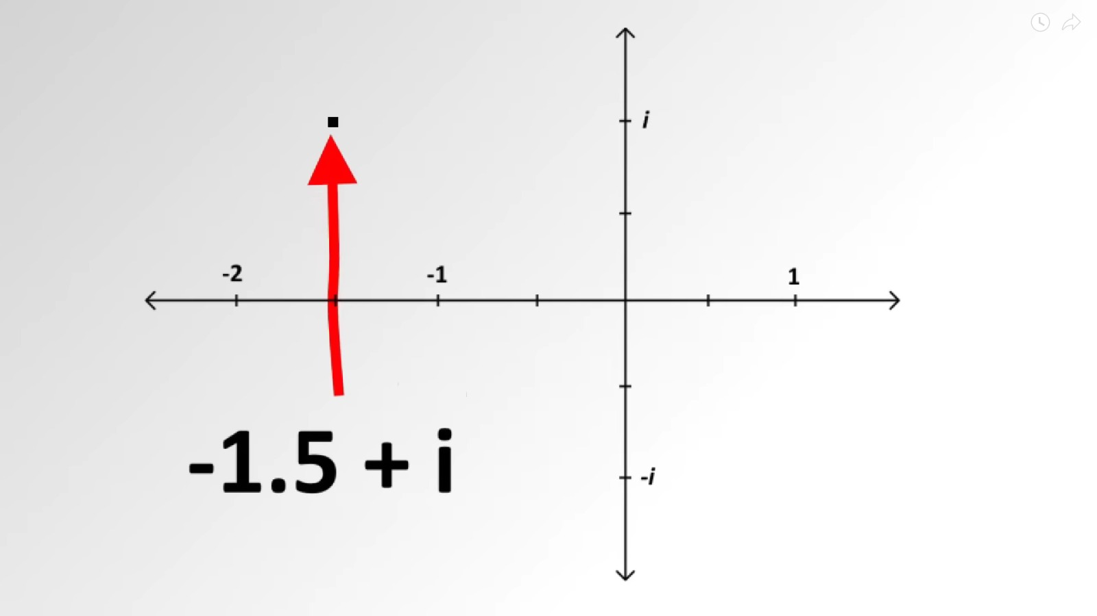

Slide 23
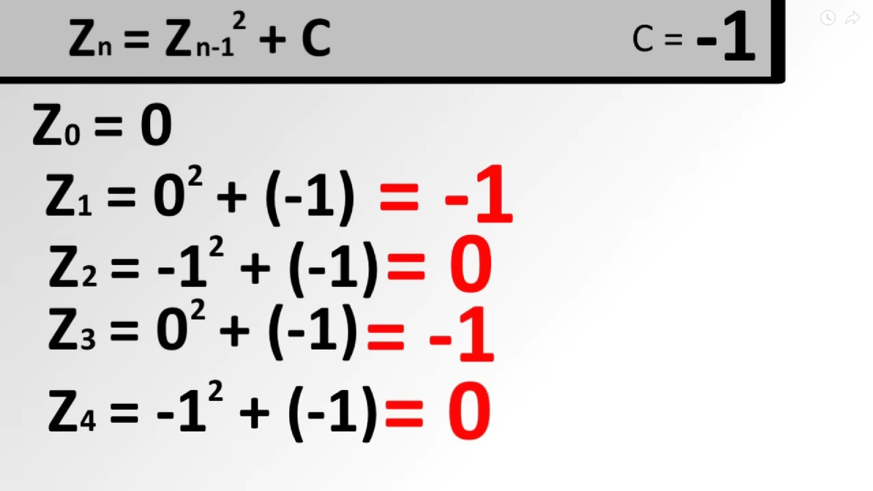

Slide 24


Slide 25
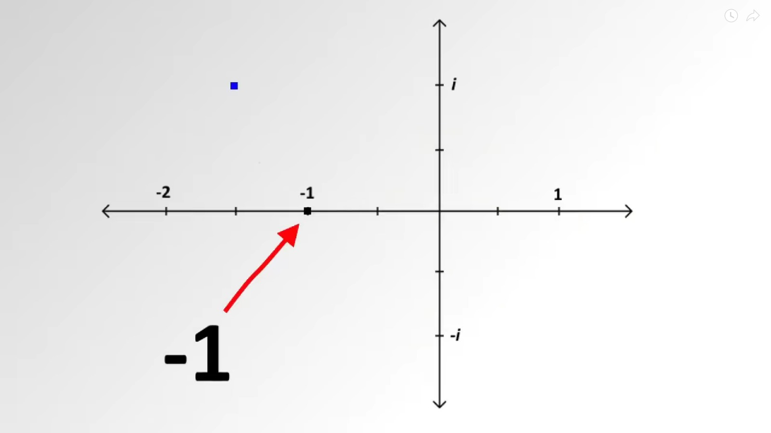

Slide 26
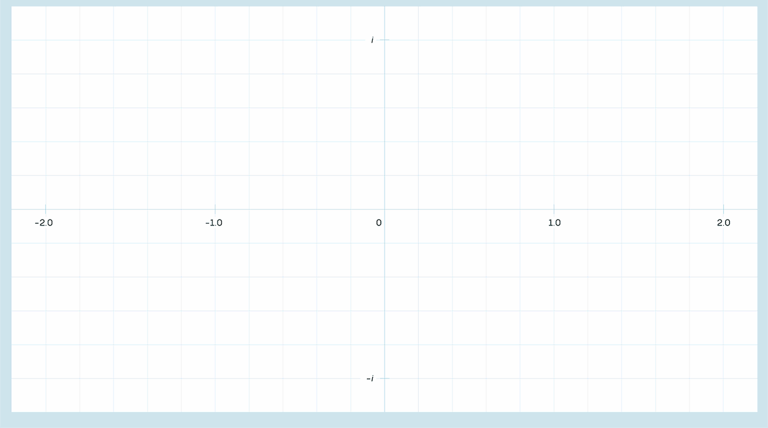

Slide 27
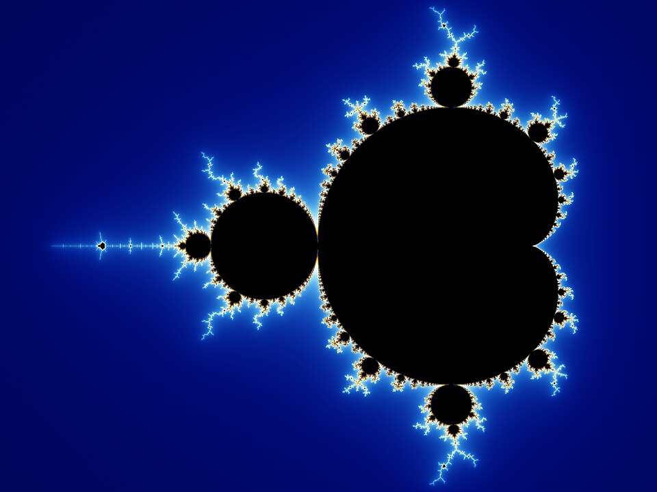

Slide 28
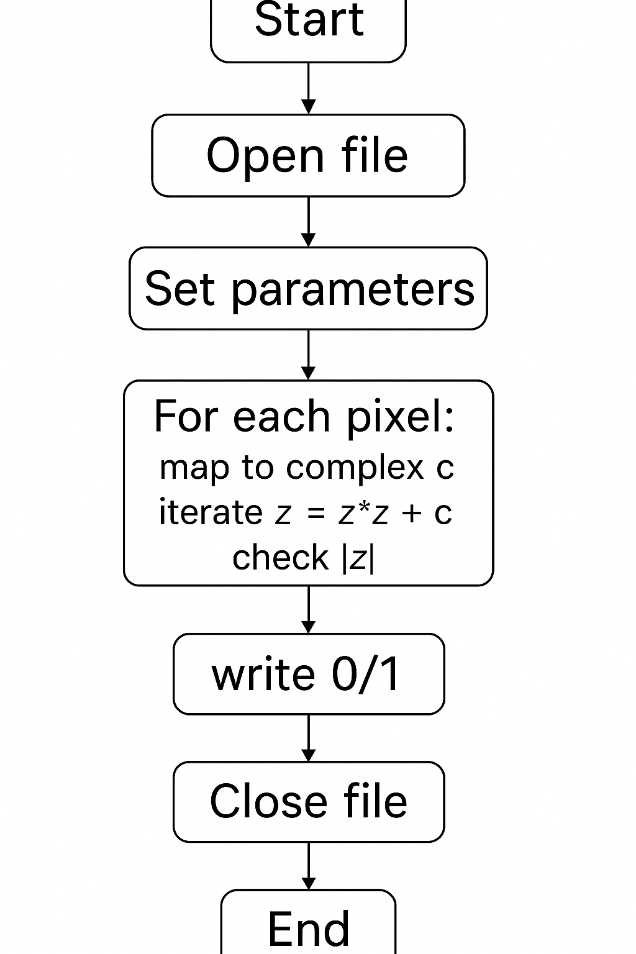
Algorithm (Flow)
Steps:
Initialize parameters — width, height, max iterations.
Loop over each pixel on the screen.
Map pixel to complex coordinate (x + yi).
Apply iteration: z = z² + c.
Assign output 0 or 1 depending on escape status..
Save pixel data to file.

Slide 29

Code Snippet
Code Output
// Escape-time function
int mandelbrot(double complex c) {
double complex z = 0;
int n = 0;
while (cabs(z) <= 2.0 && n < MAX_ITER) {
z = z*z + c; // z = f(z,c)
n++;
}
return (n == MAX_ITER); // 1 = inside, 0 = outside
}
for (int py = 0; py < HEIGHT; py++) {
for (int px = 0; px < WIDTH; px++) {
double x = x_min + (x_max - x_min) * px / (WIDTH - 1);
double y = y_min + (y_max - y_min) * py / (HEIGHT - 1);
double complex c = x + y * I;
int inside = mandelbrot(c);
fprintf(fp, inside ? "0" : "1");
}
fprintf(fp, "\n");
}

Slide 30
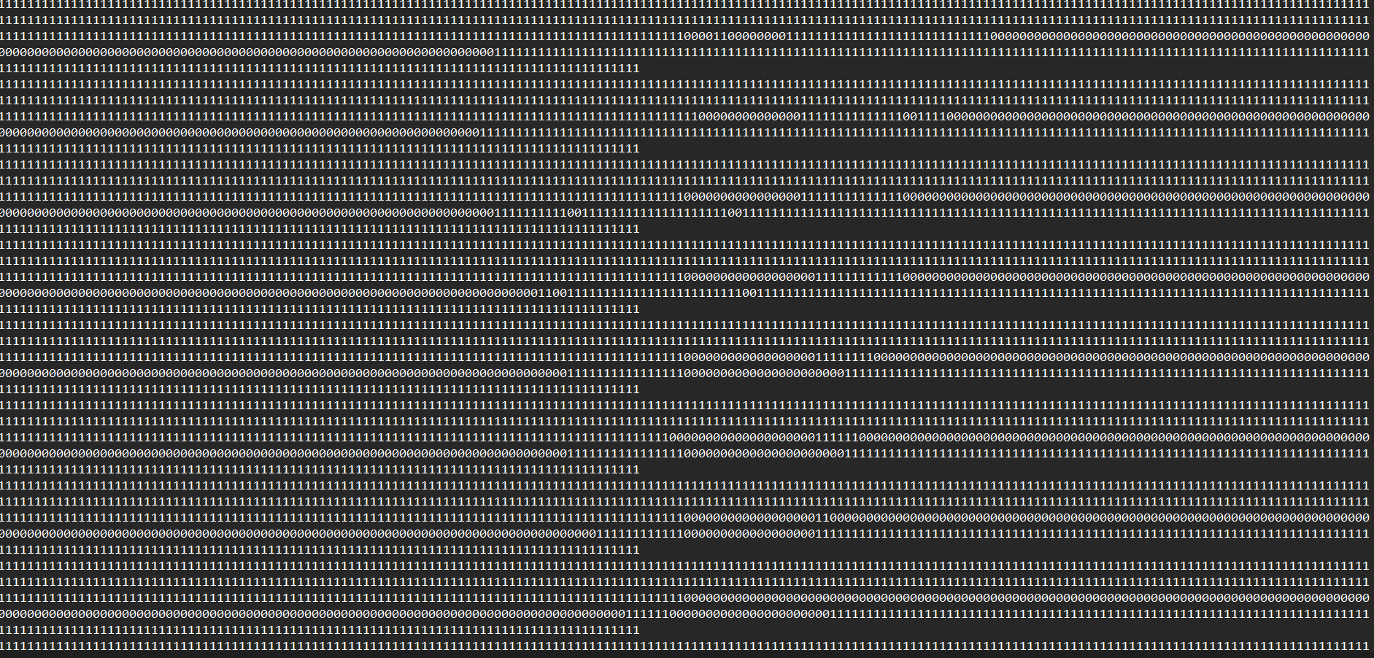
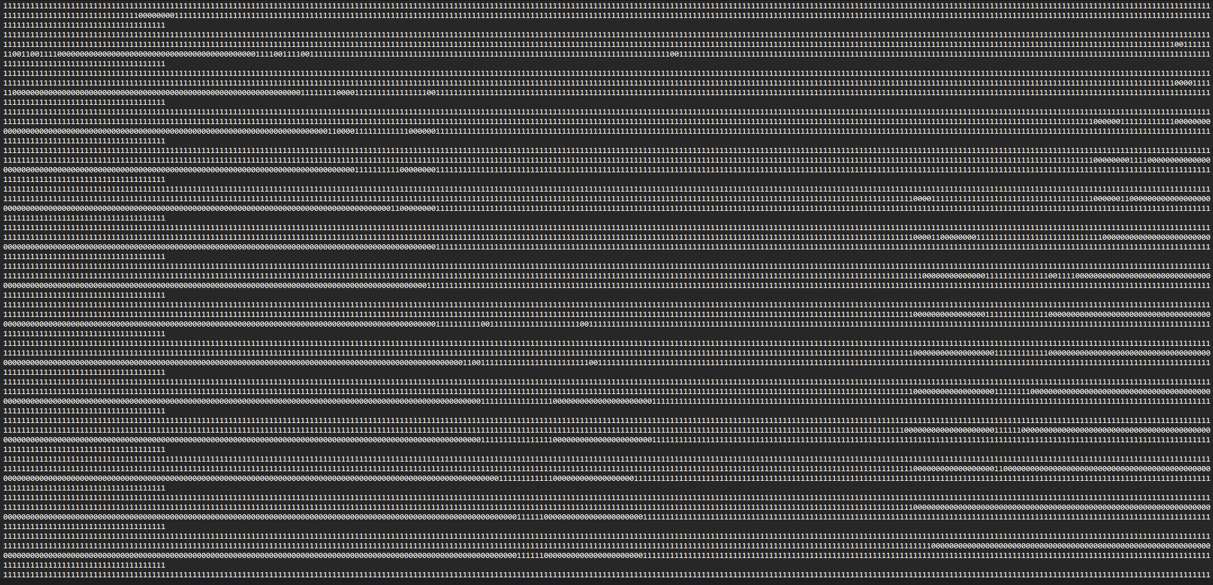
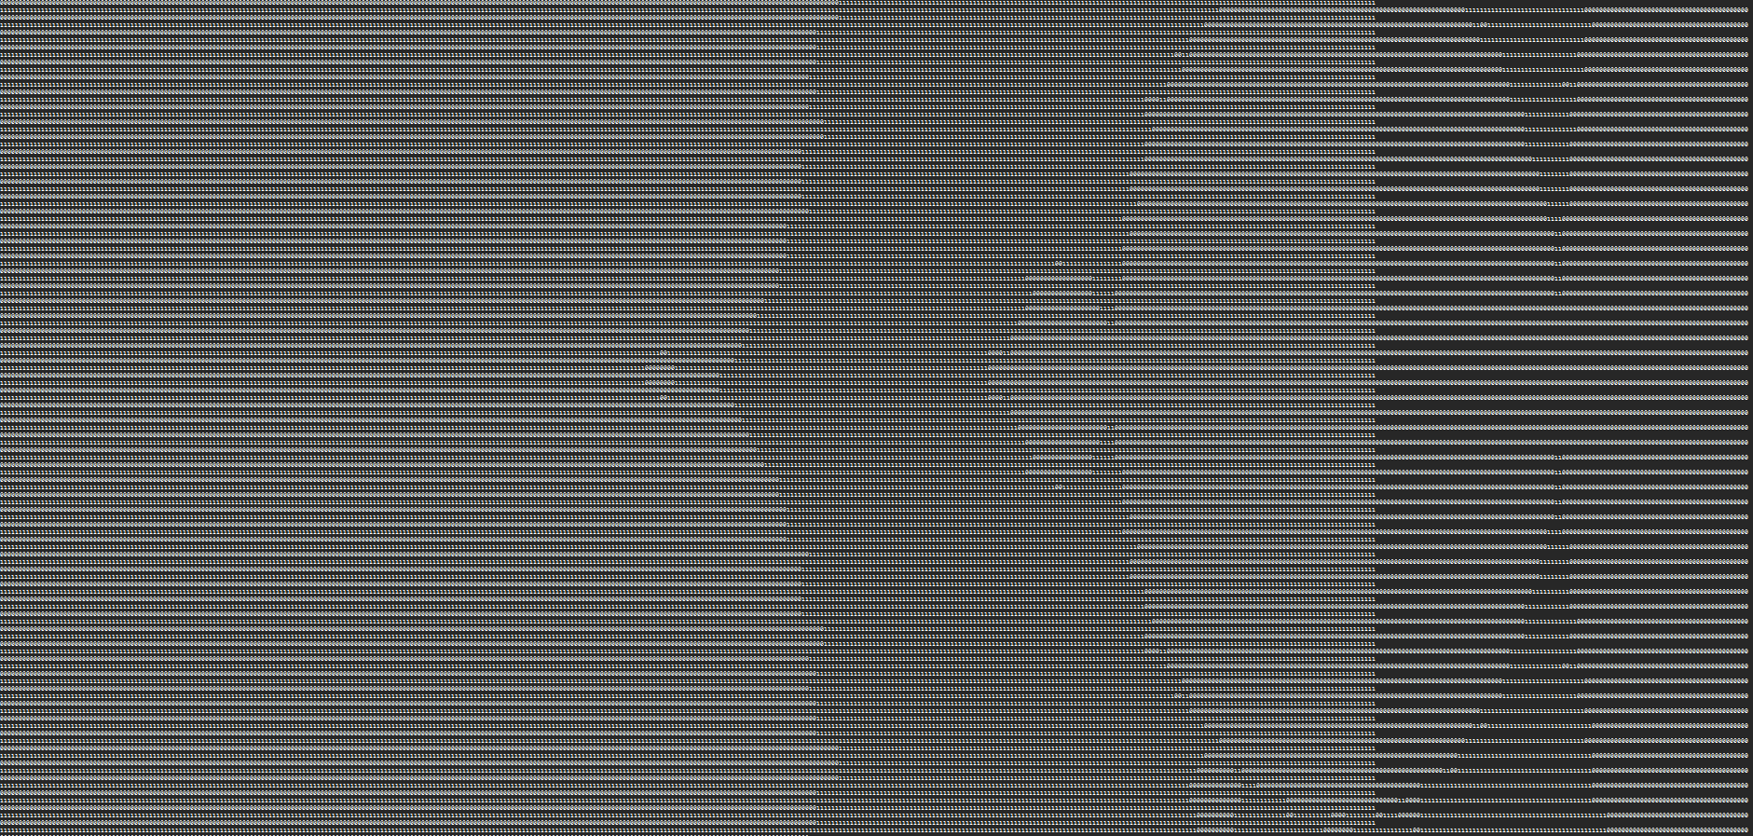
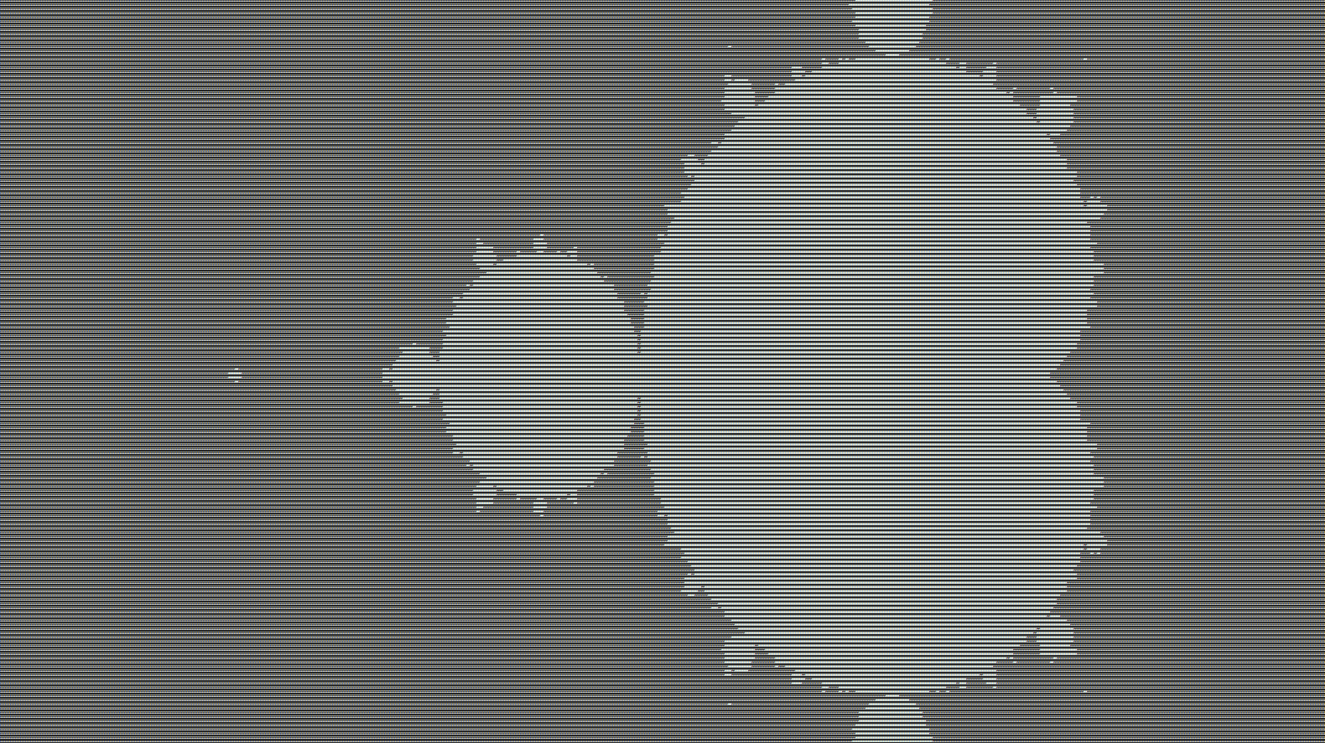

Slide 31

Implementation in C
Technical Stack
Language: C99 standard
Key headers: stdio.h, complex.h
Output format: TXT (text file)
Build command:
gcc -o mandelbrot mandelbrot.c –lm
gcc -o julia julia.c –lm
gcc -o tricorn tricorn.c -lm

Slide 32
Output Generation
Output file: mandelbrot.txt
Image Resolution: 420 × 236 pixels.
“0”, inside Mandelbrot set, “1”, outside.

Slide 33
Other Fractals (Extension)
Experimented with:
Julia Set → zn+1=zn2+kz_{n+1} = z_n^2 + kzn+1​=zn2​+k
Tricorn Set → zn+1=znˉ2+cz_{n+1} = \bar{z_n}^2 + czn+1​=zn​ˉ​2+c
Observed distinct fractal patterns.
Demonstrated flexibility of code for modification.

Slide 34

Julia and Tricorn: Fascinating Variants
Julia Sets
The Tricorn (Mandelbar)
The Julia set uses the same quadratic iteration but with a crucial difference:
This variant introduces the complex conjugate, creating unique symmetry:
Here, c is a fixed complex constant whilst z_0 equals the pixel coordinate. Different values of c produce dramatically different fractal shapes—from connected dragons to scattered dust.
The conjugate operation reflects points across the real axis, generating distinctive heart-shaped features and altered self-similarity patterns.
Escape condition: For all three sets, we test whether |z| > 2. If this occurs before MAX_ITER iterations, the point escapes. Otherwise, it belongs to the set's interior .

Slide 35
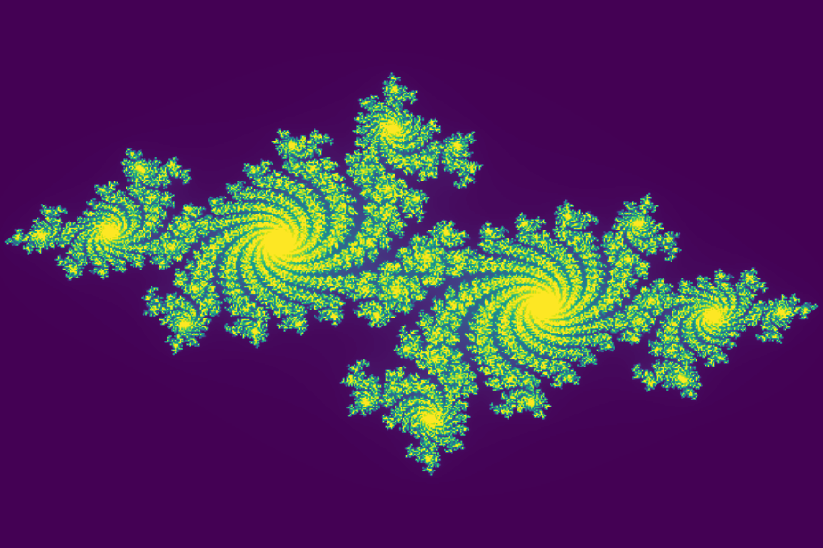
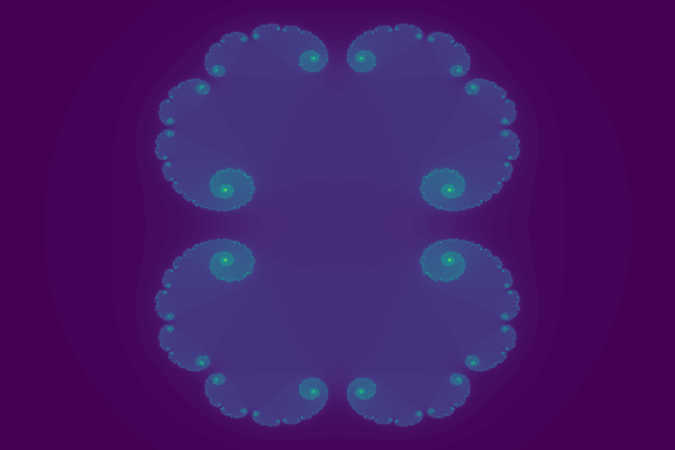
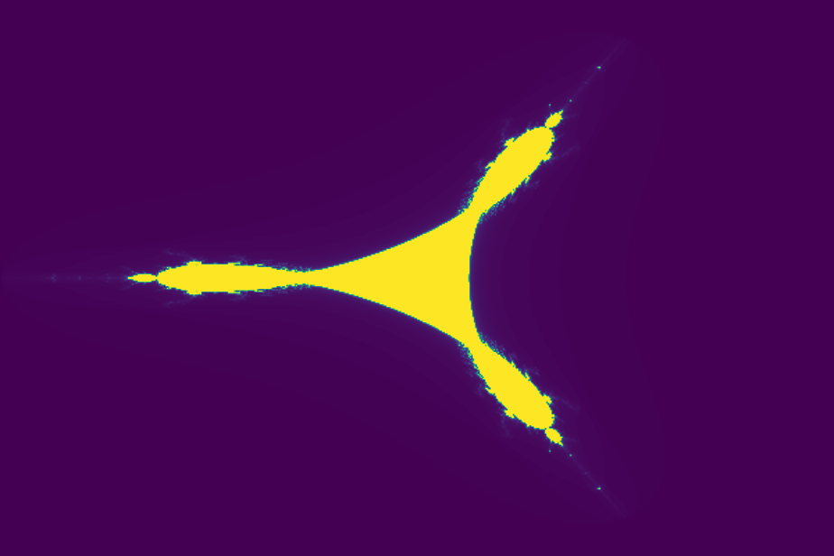
Results: Julia
Results: Tricorn

Slide 36
Testing & Debugging
Verified for different resolutions (400×400, 800×800).
Tested with varying MAX_ITER values.
Fixed:
Overflow of complex numbers.
File writing errors.
Result validation with expected fractal shape.

Slide 37
Conclusion & Future Scope
Conclusion:
Project achieved accurate fractal generation.
Showed mathematical and programming integration.
Future Scope:
Zoom & interactive GUI.
Parallel GPU rendering.
Real-time fractal animation.

Slide 38
Results & Analysis
Successfully visualized Mandelbrot fractal.
Observed:
Infinite self-similarity.
Complex boundary structures.
Dependence on iteration depth.
Demonstrated link between math and art.

Slide 39
References
1. Wikipedia: Plotting algorithms for the Mandelbrot set
2. LibreTexts: Julia and fractals
3. Project notes

